Slide 1

YOLO Segmentation and Extensions (YOLOACT, SAC)
CS7.505 Spring 2025
22th Feb 2025
Makarand Tapaswi
Ravi Kiran Sarvadevabhatla
Lecture by Deepti Rawat, PhD candidate and Keshav Gupta, B.Tech (Hons) - CVIT

Slide 2
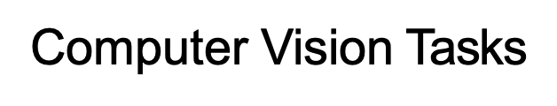
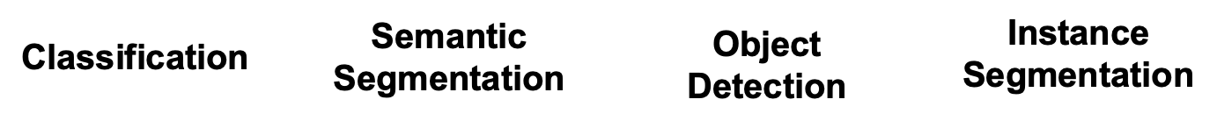
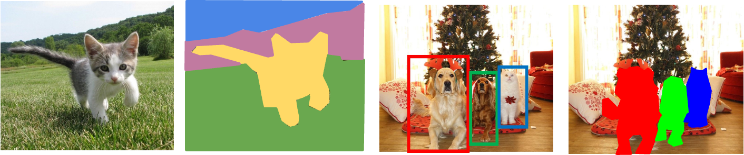
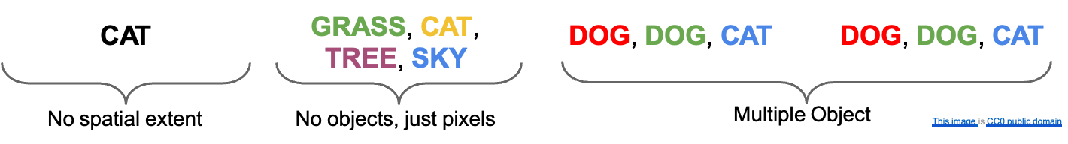

Slide 3
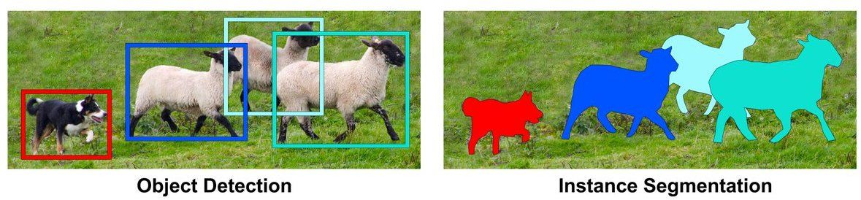
Instance Segmentation - The Problem
Instance Segmentation is much harder than bounding box prediction.
For predicting bounding boxes, we had to predict 4 parameters (x, y, w, h) for every grid cell. Instead, for instance segmentation, we would need to predict the entire binary mask for every grid cell.

Slide 4

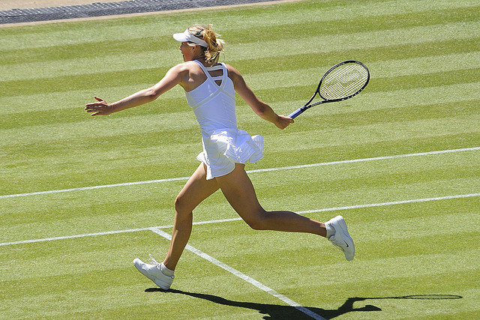

Mask Representation
We have a binary mask representation for every ground truth instance mask corresponding to the image.
GT Mask 1
- (H x W)
GT Mask 2
- (H x W)
Image - (H x W x 3)

Slide 5
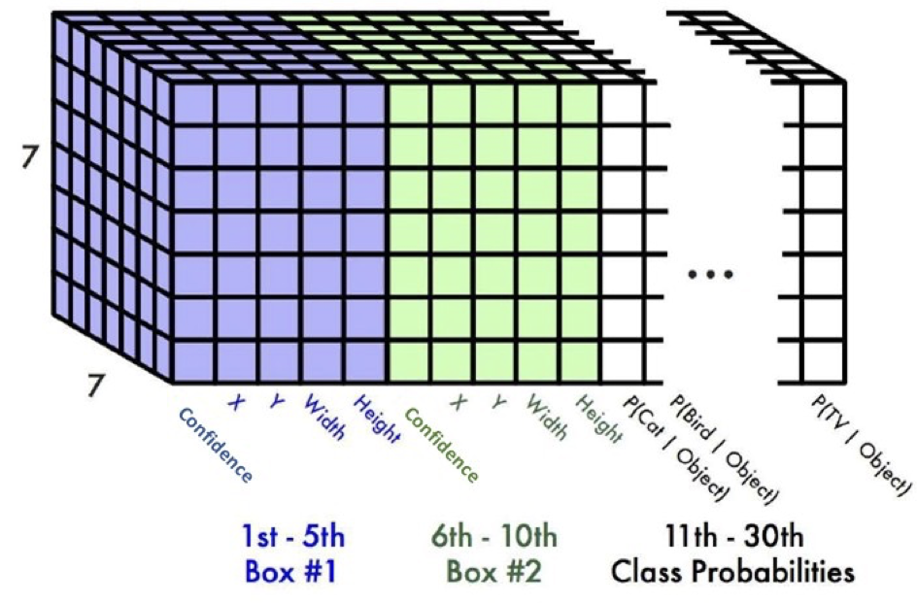
Bounding Boxes from YOLO - Recap
From the backbone we get a 7 x 7 x 30 feature map
For every location of the feature map, we have a 30-D prediction vector
Confidence and parameters of 2 bounding boxes - (1+4) x 2 = 10
Classification scores for 20 classes

Slide 6
Bounding Boxes from YOLO - Recap
Instance segmentation appears to be a similar problem to object detection, as both require predicting something for each grid cell.
Question:
Can we reuse the YOLO architecture to solve
this problem?

Slide 7
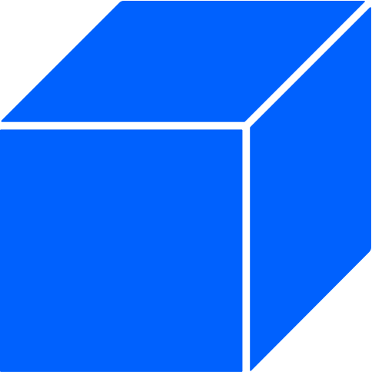
Instance Segmentation (Idea #1)
Question:
What do we need to change in the YOLO architecture to predict binary masks for every object in the image?
Bounding Box - (xywh)
Classification Scores

Slide 8
Instance Segmentation (Idea #1)
For every location, we would need to predict a binary mask of shape (H’ x W’).
We predict logit scores of size H’ x W’ along with the normal prediction vector for YOLO
BBox (xywh)
Classification Scores
Binary Mask Logits

Slide 9
Problems with Idea #1
The number of mask logits depend on the resolution of the input image (448 x 448). If we want to predict a binary mask downsampled by a factor of 4, then that would yield 448/4 x 448/4 = 12,544 extra numbers to predict per location
Also, this method won’t work if we input an arbitrary sized image, as the downsampled mask shape depends on the input shape, and therefore we can’t fix the number of binary mask logits in the prediction vector
We want to share as many parameters as possible, as well as make it possible to predict instance masks for any input image resolution.

Slide 10
Instance Segmentation (Idea #2) - Reusing Intermediate Feature Maps
Feature maps from the convolutional backbone depend on the input resolution directly. We can transform them parallely using another upsampling head (using deconvolutions) to predict latent feature maps downsampled by a factor of 4, with skip connections with the rest of the backbone as well.
These feature maps are now exactly the size we want, and we want to think of converting them to binary masks based on a reference vector.

Slide 11
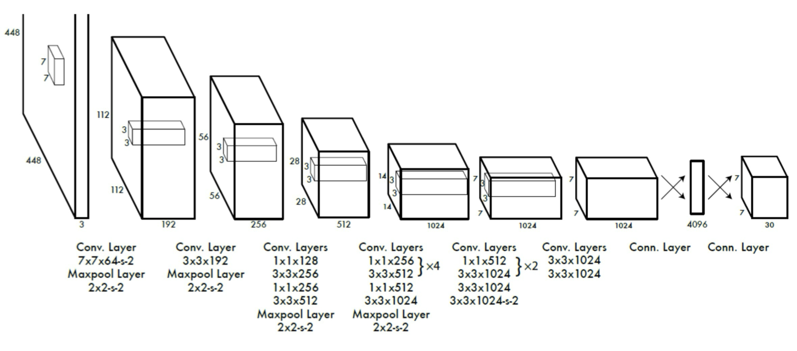
Instance Segmentation (Idea #2)
F
(H’ x W’ x K)
Deconv Layers Upsample

Slide 12
Instance Segmentation (Idea #2)
Each position instead encodes a lightweight latent reference feature vector K(=32 dim), corresponding to the object at that location.
Bounding Box - (xywh)
Classification Scores
Latent Feature Vector
f ∊ R^{K}

Slide 13
Instance Segmentation (Idea #2)
Each position instead encodes a latent feature vector corresponding to the object at that location.
Now, train this latent vector to be similar to vectors in the parallel feature map, F at the locations where the gt mask is 1 and dissimilar to the locations where the gt mask is 0.
BBox (xywh)
Cls Scores
Latent Feature Vector
f ∊ R^{K}

Slide 14
Instance Segmentation (Idea #2)
F
(H’ x W’ x K)
BBox (xywh)
Cls Scores
Latent Feature Vector
f ∊ R^{K}

Slide 15
Instance Segmentation (Idea #2)
F
(H’ x W’ x K)
Latent Feature Vector
K dim
f ∊ R^{K}
Compute Similarity - Dot Product
at every location of F to get mask logits for f

Slide 16
Instance Segmentation (Idea #2)
F
(H’ x W’ x K)
Latent Feature Vector
f ∊ R^{K}

Slide 17
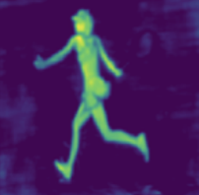
Instance Segmentation (Idea #2)
F
(H’ x W’ x K)
f ∊ R^{K}
Predicted Instance Mask
(H’ x W’)
Sigmoid

Slide 18
Instance Segmentation (Idea #2)
F
(H’ x W’ x K)
f ∊ R^{K}
Predicted Instance Mask
Ground Truth Instance Mask
(H’ x W’)
(H’ x W’)
Sigmoid
BCE Loss

Slide 19
Instance Segmentation (Idea #2)
This idea was presented in the paper:
YOLACT Real-time Instance Segmentation (https://arxiv.org/pdf/1904.02689)
Daniel Bolya, Chong Zhou, Fanyi Xiao, Yong Jae Lee
University of California, Davis
ICCV 2019

Slide 20
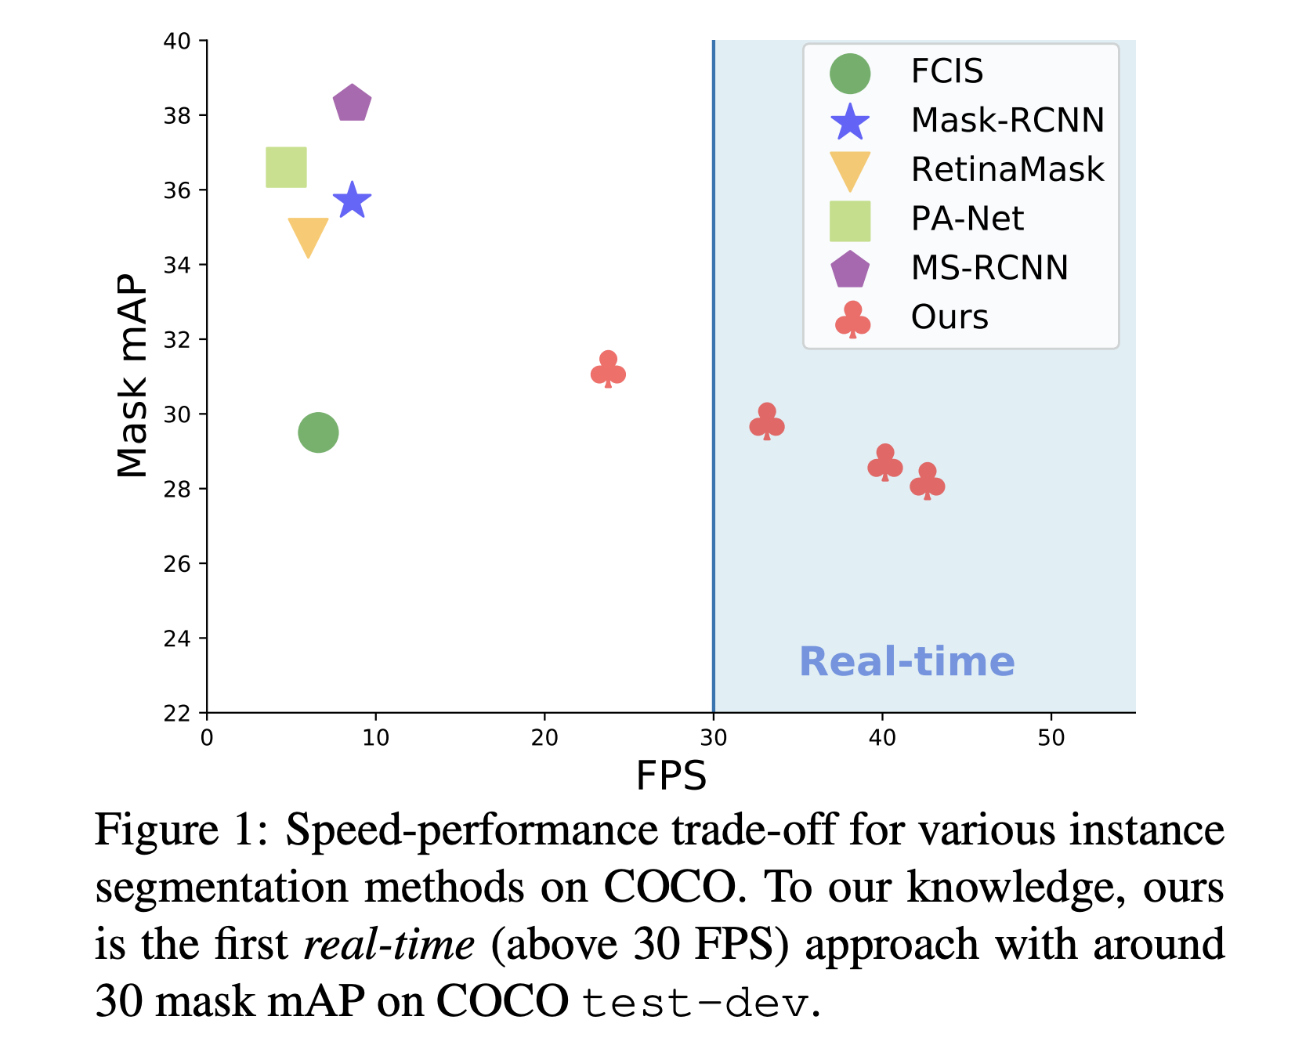
Performance
Much more computationally efficient than other 2 stage approaches like Mask-RCNN.
Achieves similar mAP compared to other approaches.
Parameter sharing, as we use one feature map F, for predicting the mask logits at every location in the grid.

Slide 21
Segmentation and Cross Association - YOLO

Slide 22
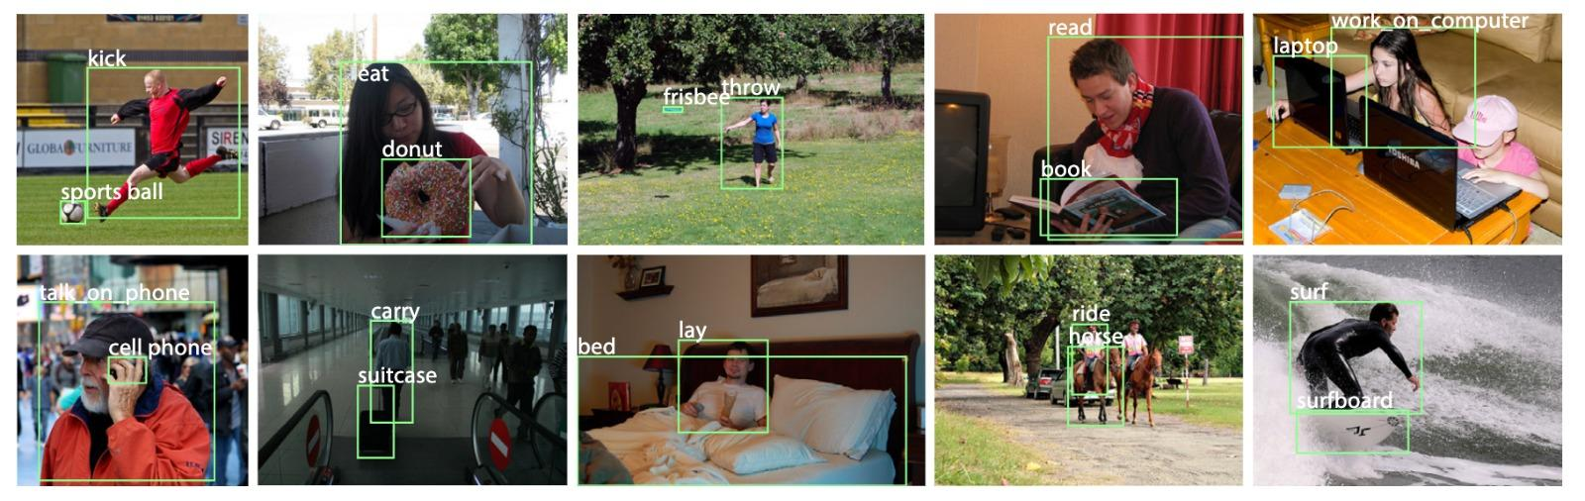
Relationship between different entities in an image
Till now, we have understood how to locate an object of interest via detection and instance segmentation. However, some problems require us to understand the association between different objects in a scene

Slide 23
Relationship between different entities in an image
What is association?
Connection between instances of objects of 2 different classes.
Ex - (Person - skateboard), (Person - Horse), (Rider - Motorcycle)

Slide 24

Application: Triple Riding Detection
Let’s explore the idea of “Association” in terms of the application of Triple Riding Detection
Question:
With all the knowledge that you have, how would you approach this problem?
Objective:
We need to somehow find – which Rider is associated with which Motorcycle

Slide 25
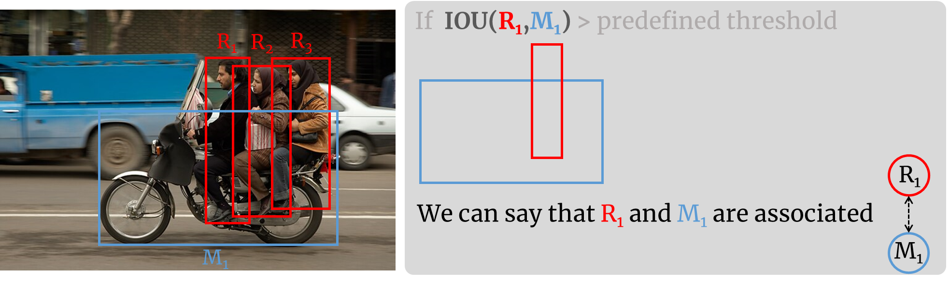
IOU-based Approach
Train a YOLO detector on two classes – Rider and Motorcycle
Detect the bounding box of these two classes
Use a distance metric (like IOU) to determine how close a rider box is to a motorcycle box

Slide 26
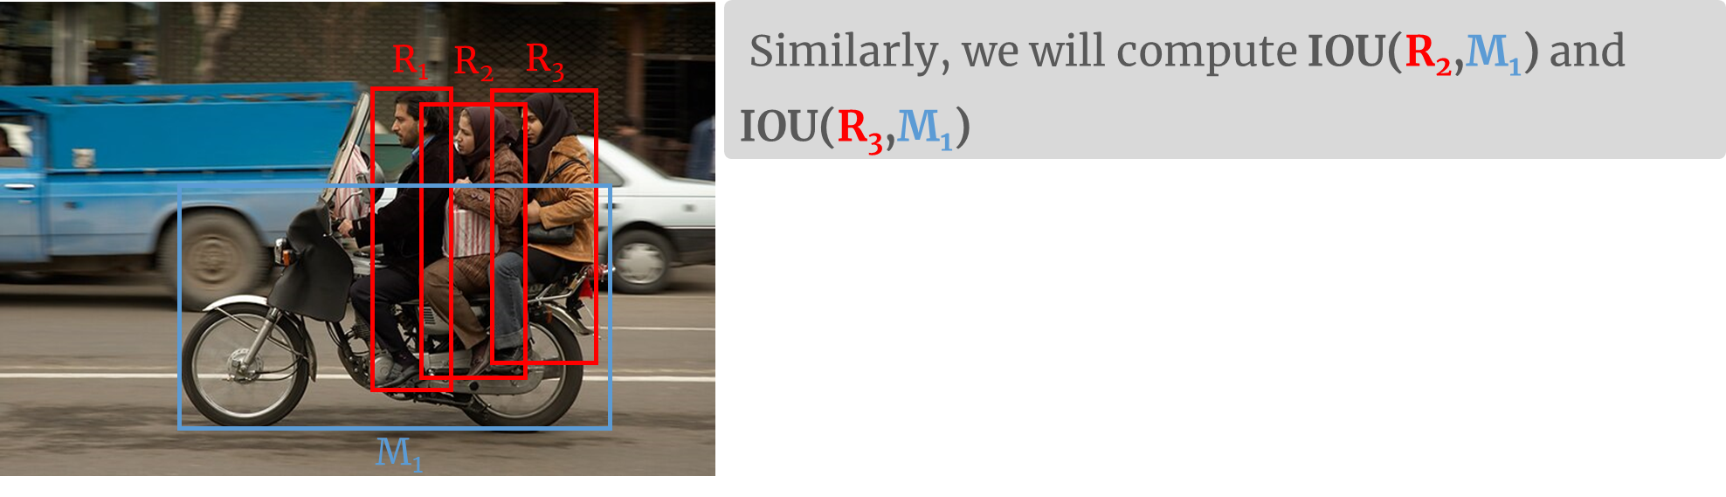
IOU-based Approach
4. Finally, count the number of riders that have a high IOU (say ≥ 50%) with the same motorcycle
5. If the count >=3, flag it as a triple riding violation

Slide 27
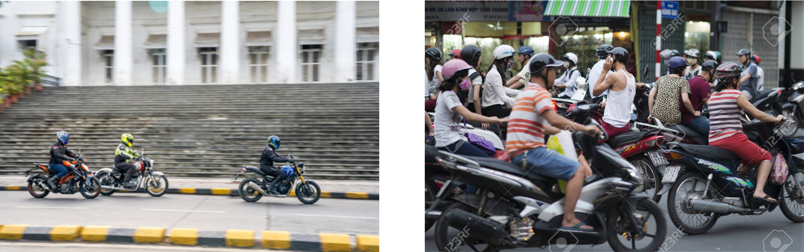
IOU-based Approach: Limitation
This approach might work well in less-crowded areas but might fail in crowded area
Question: Could you guess why?

Slide 28
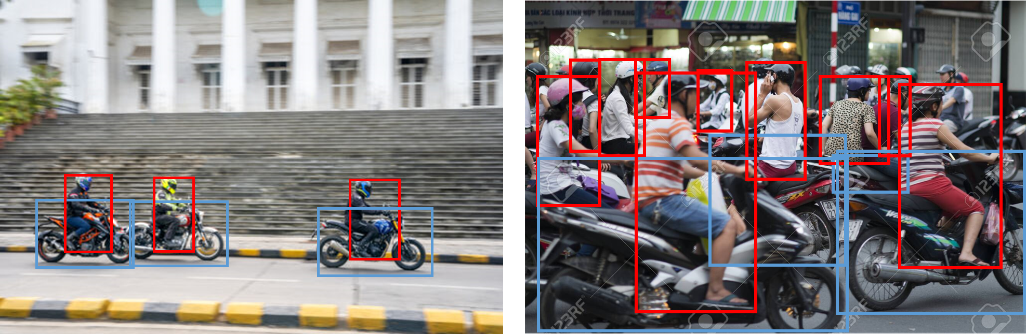
IOU-based Approach: Limitation
The IOU method would fail in crowded area, as one rider box may have a high IOU with multiple motorcycle boxes.

Slide 29
Question:
Then how do we determine which rider is associated with which motorcycle?
Objective:
We need someway to accurately associate riders with their motorcycles
How: Can we can modify the YOLO instance segmentation architecture to model the association between the objects of two classes?

Slide 30

This idea is explored in this work:
DashCop
Automated E-ticket Generation for Two-Wheeler Traffic Violations Using
Dashcam Videos
https://dash-cop.github.io/

Slide 31
Segmentation and Cross Association (SAC)
Question:
How can we change the YOLO architecture for instance segmentation to account for association as well?
We need to capture the dependency of every object of Class A with every object of Class B - whether they are associated or not?
Let us explore the idea of SAC through a simple example where we want to predict the association between 2 classes - (Person) and (Tennis Racket)

Slide 32
Mask Representation
We have a binary mask representation for every ground truth instance mask corresponding to the image.
Also, for every ground truth instance mask, we have a ground truth associated mask.
For ex - The 2 masks on the right are associated with each other, i.e Mask 2 is the associated mask for 1 and vice-versa. This is because the person in the image is associated with the tennis racket, and our task is to predict these associations.
GT Mask 1
(H x W)
GT Mask 2
(H x W)
Image - (H x W x 3)

Slide 33
SAC
F
F’
(H’ x W’ x K)
(H’ x W’ x K)
Deconv Layers Upsample

Slide 34
SAC
Each position instead encodes a latent reference feature vector corresponding to the object at that location. This shall now also encode the features required to predict its associated class object as well.
Bounding Box - (xywh)
Classification Scores
Latent Feature Vector
f ∊ R^{K}

Slide 35
SAC
F
F’
(H’ x W’ x K)
(H’ x W’ x K)
BBox (xywh)
Cls Scores
Latent Feature Vector
f ∊ R^{K}

Slide 36
SAC
F
F’
(H’ x W’ x K)
(H’ x W’ x K)
BBox (xywh)
Cls Scores
Latent Feature Vector
f ∊ R^{K}
Compute Similarity - Dot Product
at every location of F to get mask logits
for object at the location of f
Compute Similarity - Dot Product
at every location of F’ to get mask
logits for associated object for the object present at location of f

Slide 37
SAC
F
F’
(H’ x W’ x K)
(H’ x W’ x K)
f ∊ R^{K}

Slide 38
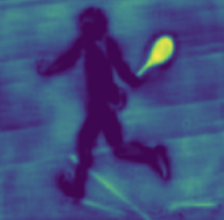
SAC
F
F’
(H’ x W’ x K)
(H’ x W’ x K)
Sigmoid
Sigmoid
f ∊ R^{K}
Predicted Instance Mask - (H’ x W’)
Predicted Associated Instance Mask - (H’ x W’)

Slide 39
SAC
F
F’
(H’ x W’ x K)
(H’ x W’ x K)
Sigmoid
f ∊ R^{K}
Sigmoid
Predicted Instance Mask - (H’ x W’)
Ground Truth Instance Mask - (H’ x W’)
Predicted Associated Instance Mask -
(H’ x W’)
BCE Loss
BCE Loss
Ground Truth Associated Instance Mask -
(H’ x W’)

Slide 40
SAC
Let us now understand SAC through a real world example of predicting associations among riders and motorcycles.

Slide 41
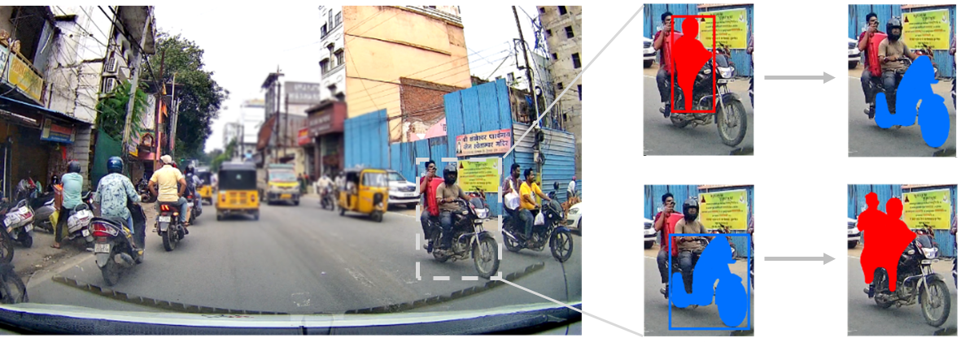
Segmentation and Cross-Association (SAC)
Idea: Instead of treating riders and motorcycles independently, we want a mechanism that learns the relationship between these two different classes during training itself!
Objective:
Given this
Learn this

Slide 42
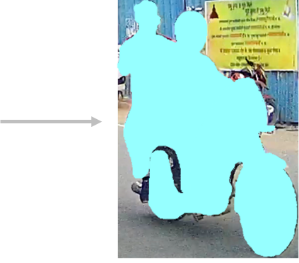
SAC
Idea: Instead of treating riders and motorcycles independently, we want a mechanism that learns the relationship between these two different classes during training itself!
(1)
(2)
(3)
Once we learn which rider is associated with which motorcycle (2), also known as cross-object association, we can link them together (3)

Slide 43
SAC
Objective:
Detect both riders and motorcycles
Learn the cross-object association to accurately associate a rider with its motorcycle
Let’s see how to accomplish these two tasks jointly during the training!

Slide 44
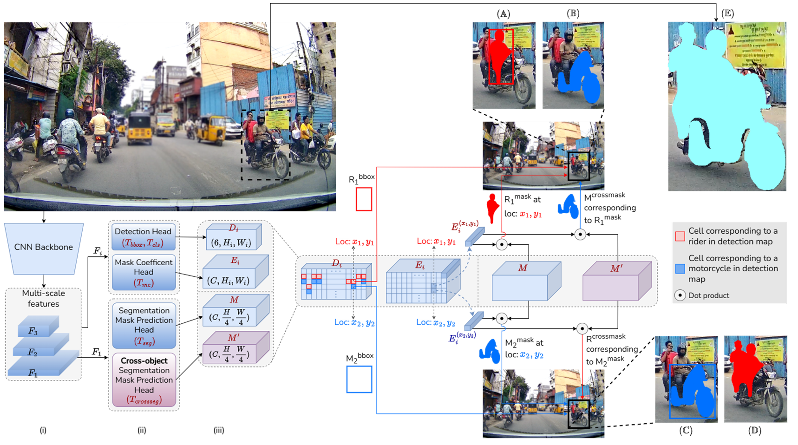
SAC Architecture

Slide 45
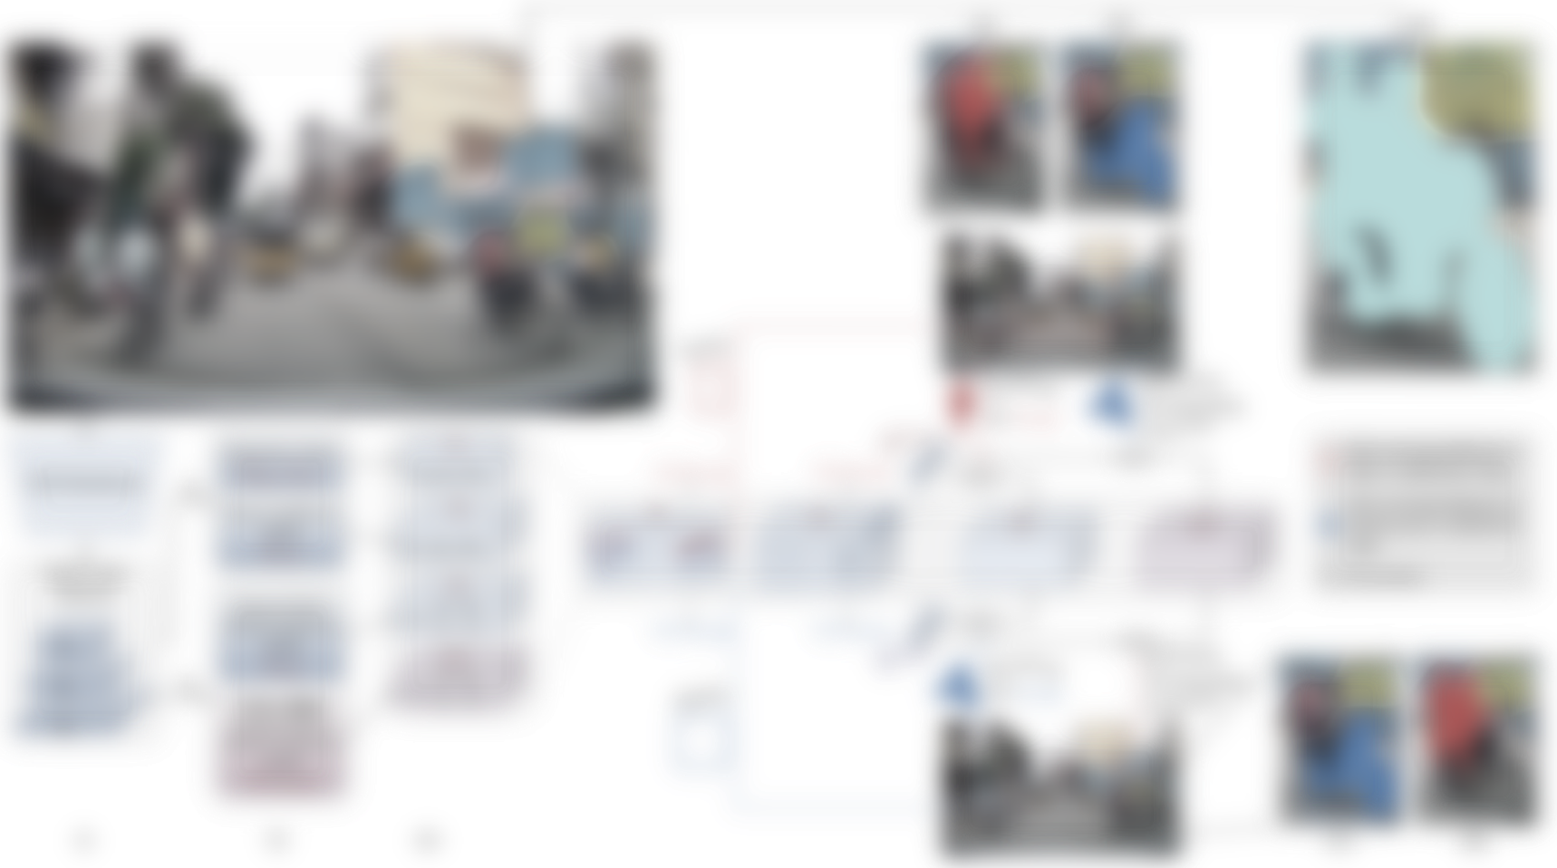
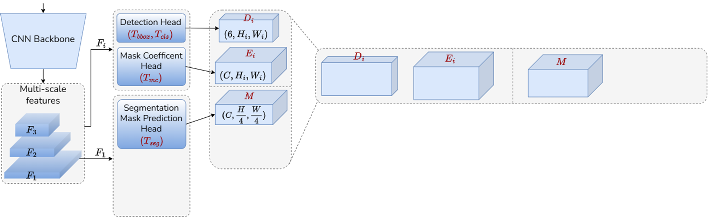
SAC
Segmentation and Cross-association (SAC) is built on top of YOLOv8 (blue)

Slide 46

YOLOv8
Segmentation and Cross-association (SAC) is built on top of YOLOv8 (blue)
So, let’s understand YOLOv8

Slide 47
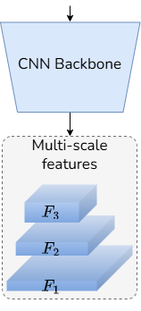
YOLOv8
Backbone: YOLOv8 uses a modified version of CSPDarknet53 (Cross Stage Partial Darknet-53) which is a CNN backbone architecture.
Given an image, the CNN backbone extracts features at three-different scales
YOLOv8's architecture is designed to predict bounding boxes and class probabilities at multiple scales, allowing it to effectively detect objects of various sizes within the same image.

Slide 48
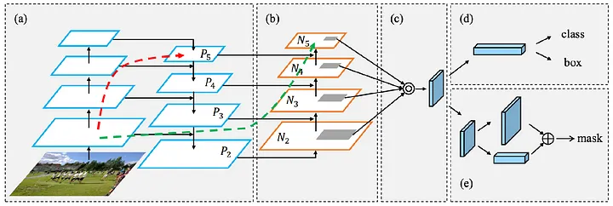
YOLOv8
Neck: This part is in charge of fusing the features extracted by the backbone. It uses a PANet (Path Aggregation Network) to combine features at different scales. The convolutional layers P3, P4, and P5 are transmitted to various parts of the pyramid (layers 11, 14, and 20) to ensure the model can detect objects of various sizes.
PANet: https://arxiv.org/abs/1803.01534

Slide 49
YOLOv8
Head: This consists of three detection heads, which are connected to the three outputs of the PANet. These detection heads generate bounding boxes, assign confidence scores, and classify the boxes according to their categories. They also eliminate redundant detections of the same object, which may appear at different scales.
Relevant read: medium

Slide 50
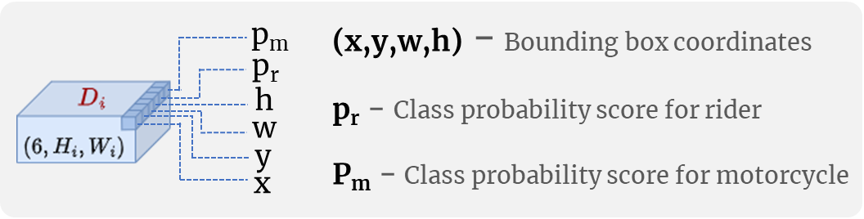
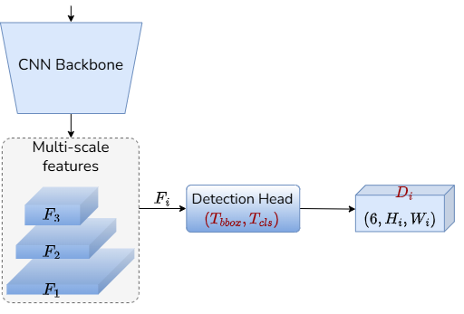
YOLOv8: Detection Head
For each feature map F_{i} , Detection Head predicts detection map D_{i} = [B_{i},K_{i}] where B_{i} is the bounding box coordinate prediction map and K_{i} is the class score prediction map

Slide 51
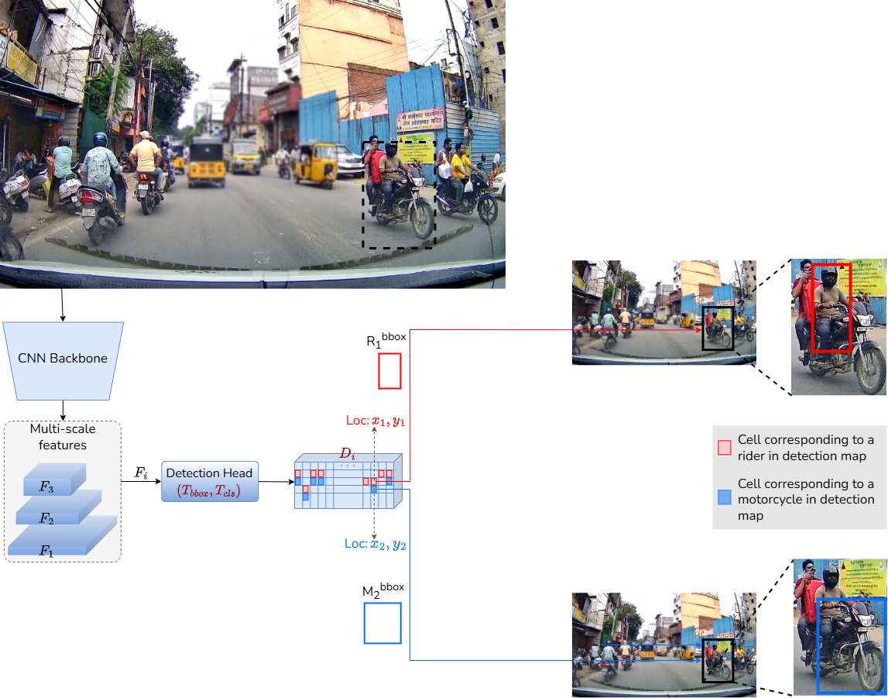
YOLOv8: Detection Head

Slide 52
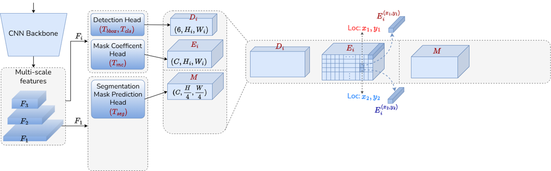
YOLOv8: Instance Segmentation
For each feature map F_{i} , Mask Coefficient Head predicts an intermediate mask coefficient embedding map E_{i} , where each embedding vector E_{i}^{xy} encodes an instance representation at a cell location (x,y)
(i)
(ii)
(iii)
(iii)

Slide 53
YOLOv8: Instance Segmentation
For each feature map F_{i} , Mask Coefficient Head predicts an intermediate mask coefficient embedding map E_{i} , where each embedding vector E_{i}^{xy} encodes an instance representation at a cell location (x,y)
In a parallel branch, Segmentation Mask Prediction Head processes the high-resolution feature map F₁ , to output a representation M
(i)
(ii)
(iii)
(iii)

Slide 54
YOLOv8: Instance Segmentation
To predict instance segmentation map S_{i}^{xy} for each spatial location in the feature map, we take the dot product between E_{i}^{xy} and M
S_{i}^{xy} = E_{i}^{xy} M
(i)
(ii)
(iii)
(iii)

Slide 55
YOLOv8: Instance Segmentation
S_{i}^{xy} = E_{i}^{xy} M
Intuitively, E_{i}^{xy} represents a query embedding, and M represents the key embedding
E_{i}^{xy} attends strongly to spatial locations where the corresponding object is present in M. Consequently, the key locations which have a high similarity with E_{i}^{xy} become a part of the final instance segmentation mask S_{i}^{xy}
(i)
(ii)
(iii)
(iii)

Slide 56
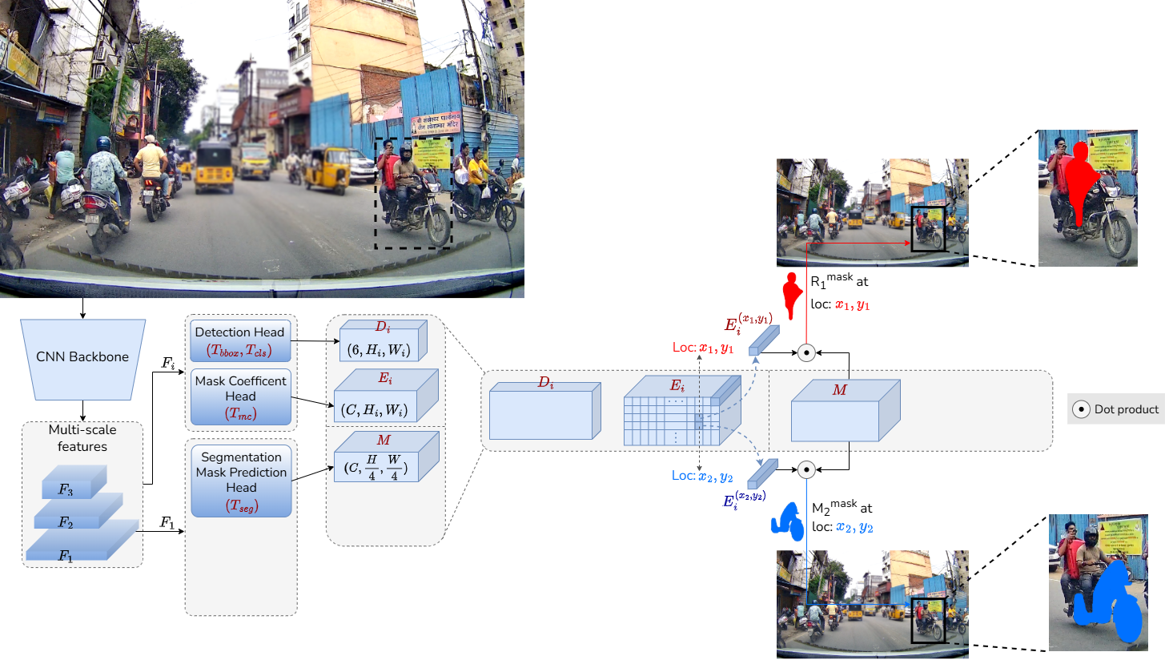
YOLOv8: Instance Segmentation
(i)
(ii)
(iii)

Slide 57
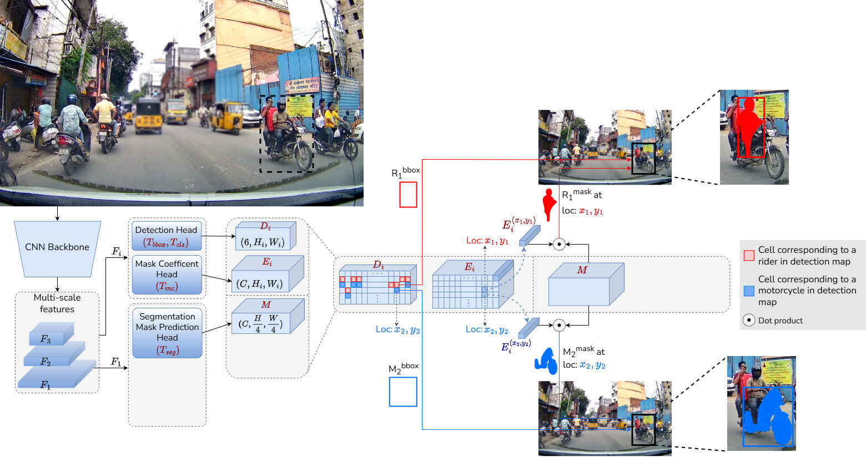
YOLOv8: Putting it all together
(i)
(ii)
(iii)

Slide 58
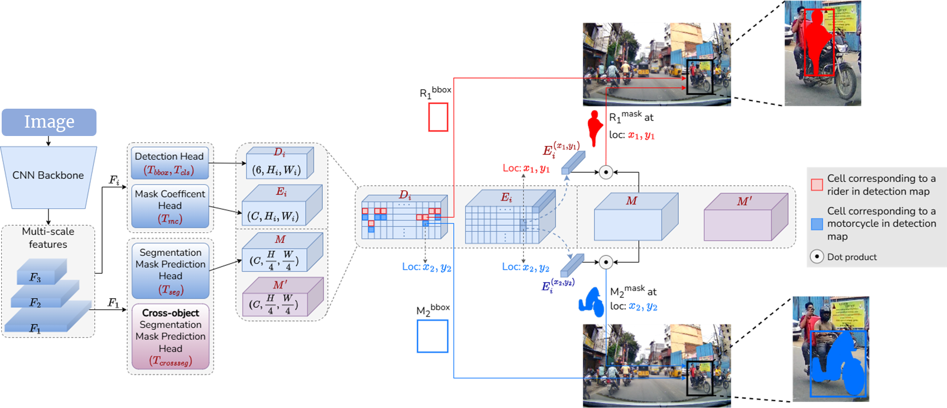
SAC: Cross-Association
To model the association between riders and their corresponding motorcycles, we introduce a Cross-object Segmentation Mask Prediction Head (purple)
(i)
(ii)
(iii)

Slide 59
SAC: Cross-Association
This head follows the same segmentation mechanism as that of instance segmentation (described previously), but with a key modification
Question: Can you guess what could be that modification from the diagram?
(i)
(ii)
(iii)

Slide 60
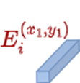
SAC: Dual Role of Embedding Vector
The embedding vector serves two crucial purposes:
1. When dotted with M, it produces the instance segmentation mask
(i)
(ii)
(iii)

Slide 61
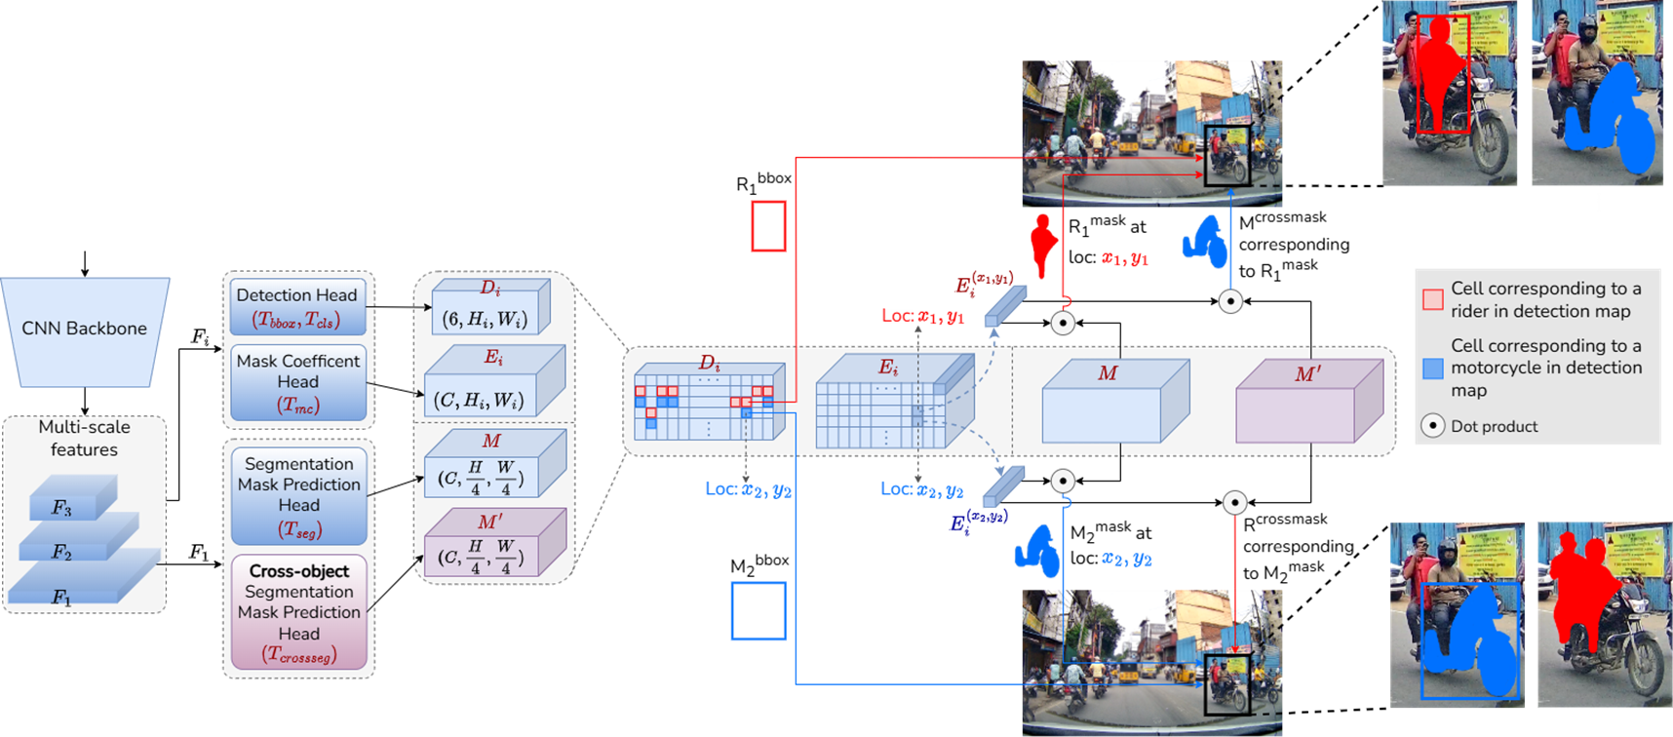

SAC: Dual Role of Embedding Vector
The embedding vector serves two crucial purposes:
2. When dotted with M’ , it produces the cross-object segmentation mask
(i)
(ii)
(iii)

Slide 62


SAC: Cross-object Prediction
This dual role allows each class to vote for the presence of its associated object in the other class
For a rider detection:
The embedding vector E_{i}^{xy} encodes the rider's features
When combined with M’ , it predicts where the associated motorcycle should be
A_{i}^{xy} = E_{i}^{xy} M’ (where A_{i}^{xy} is cross-object segmentation mask)
Conversely, for a motorcycle:
The same mechanism predicts locations of all associated riders
This creates a bidirectional association mechanism

Slide 63
SAC: Computing Final Associations
Let's look at how we go from detections to final rider-motorcycle associations

Slide 64
SAC: Computing Final Associations
During Inference, after generating three key elements for each detection: a bounding box, a segmentation mask, and a cross-object mask,
To determine if a rider and motorcycle belong together, we compute an association score using two key measurements:
First, we check how well the rider's prediction of where its motorcycle should be matches the actual motorcycle's mask
Second, we verify how well the motorcycle's prediction of where its rider should be matches the actual rider's mask
The average of these two measurements gives us our final association score
Let’s break it down!

Slide 65
SAC: Computing Final Associations
For all riders:
Let the resulting set of bounding boxes, segmentation masks, and cross-object segmentation masks, are expressed as [(B_{r}¹, S_{r}¹, A_{r}¹), ... ,(B_{r}^{N}, S_{r}^{N}, A_{r}^{N})]
Similarly for all motorcycles:
[(B_{m}¹, S_{m}¹, A_{m}¹), ... ,(B_{m}^{N}, S_{m}^{N}, A_{m}^{N})]

Slide 66
SAC: Computing Final Associations
Association score:
Compute the association score a_{k,l} between the k-th rider and l-th motorcycle:
a_{k,l} = ½ ( IOU (A_{r}^{k}, S_{m}^{l}) + IOU (S_{r}^{k}, A_{m}^{l} mask (B_{r}^{k})))
Interpretation: How well the rider's prediction of where its motorcycle should be matches the actual motorcycle's mask.
IOU ( , )
IoU between rider's cross-object mask and motorcycle's mask

Slide 67

SAC: Computing Final Associations
Association score:
a_{k,l} = ½ ( IOU (A_{r}^{k}, S_{m}^{l}) + IOU (S_{r}^{k}, A_{m}^{l} mask (B_{r}^{k})))
Interpretation: How well the motorcycle's prediction of where its rider should be matches the actual rider's mask
where mask(B) is a function that takes in a bounding box and returns a binary mask with values inside the box set to 1 and outside set to 0
IOU( , mask ( ))
IoU between rider's mask and motorcycle's cross-object mask

Slide 68
SAC: Computing Final Associations
Association score:
a_{k,l} = ½ ( IOU (A_{r}^{k}, S_{m}^{l}) + IOU (S_{r}^{k}, A_{m}^{l} mask (B_{r}^{k})))
Interpretation: In the case of a perfect overlap between the actual segmentation mask and the cross-object segmentation mask, the sum of the two IOU terms, IOU (A_{r}^{k}, S_{m}^{l}) and IOU (S_{r}^{k}, A_{m}^{l} mask (B_{r}^{k})) will result in a maximum value of 2 (i.e., 1+1)
To ensure that the association score remains within the range [0, 1], we take the average of these two IOU terms.
This guarantees that in the case of a perfect overlap, the association score reaches 1

Slide 69
SAC: Computing Final Associations
Association score:
a_{k,l} = ½ ( IOU (A_{r}^{k}, S_{m}^{l}) + IOU (S_{r}^{k}, A_{m}^{l} mask (B_{r}^{k})))
This dual verification ensures robust pairing - both the rider and motorcycle must 'agree' on their association for a high score.
It's like having two independent witnesses confirm the same story, making our associations much more reliable.

Slide 70
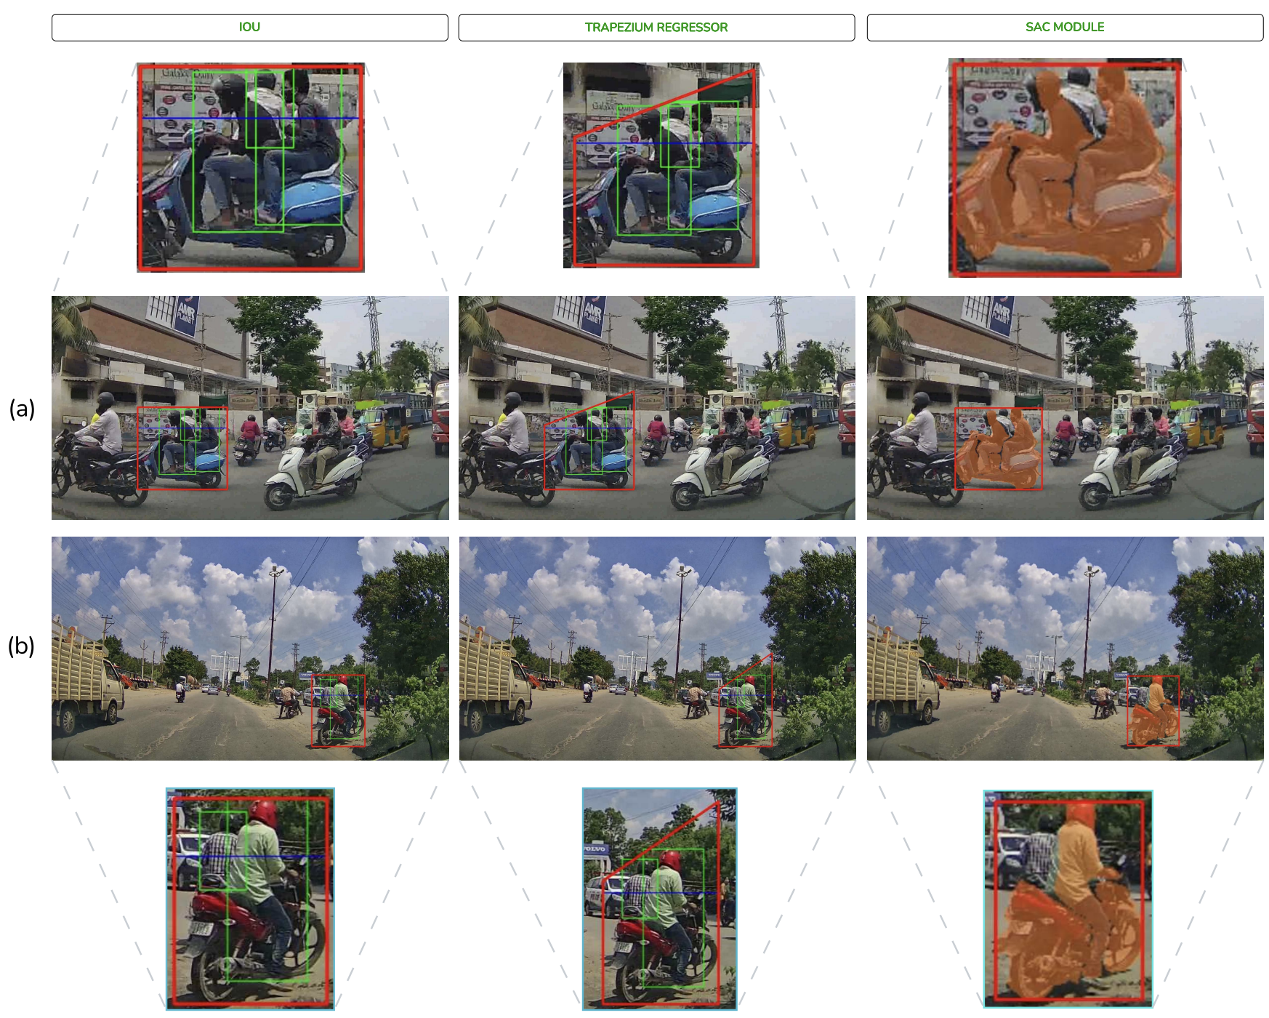
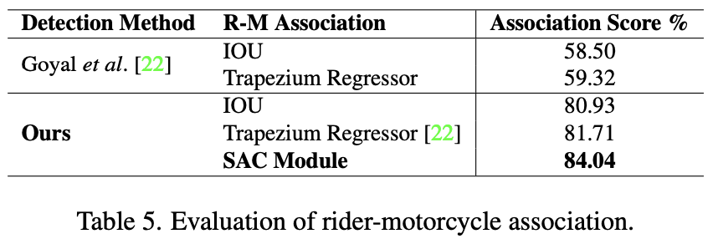
Results
We present a qualitative comparison between the Intersection over Union (IoU) method, the trapezium method, and the proposed SAC method. The results demonstrate the superiority of SAC, particularly in highly dense traffic scenarios.
Trapezium method: https://arxiv.org/abs/2204.08364

Slide 71
Results
In the first example (a), both IoU and the trapezium-based methods incorrectly associate the middle rider as a part of the R-M instance, when clearly the middle rider is not associated with the motorcycle. Both the IoU and the trapezium based methods does not take into account the visual information, and directly operates on the coordinates of the bounding boxes present.

Slide 72
Results
In contrast, SAC learns associations directly from pixel-level features, leading to more accurate associations. A similar example is shown in Fig. (b), where SAC correctly associates the rider and motorcycle

Slide 73
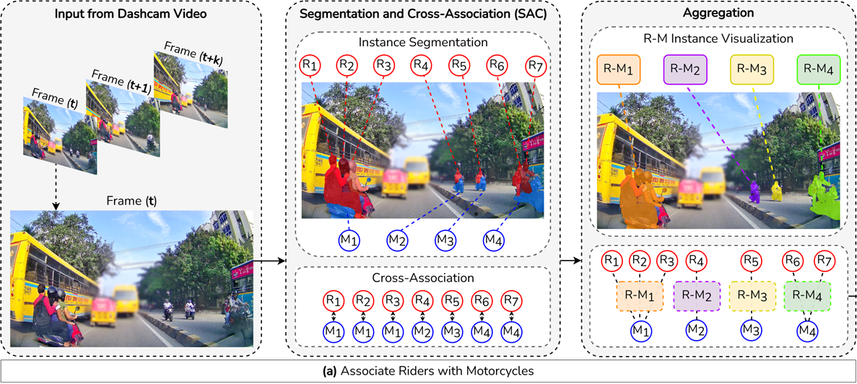
Triple Riding Violation: Bringing it all together
Each R-M instance is passed to a Triple Rider Classifier
Decision
(Yes / No)
Know more about the project at: https://dash-cop.github.io/

